Slide 1
Adult Income Census Prediction

Slide 2
Objective:
Predict whether a person has an income of more than 50K a year or not. This is basically a binary classification problem where a person is classified into the >50K group or <=50K group.

Slide 3
Dataset:
The dataset is downloaded from Kaggle.
The dataset contains 15 columns and 32000+ rows.

Slide 4
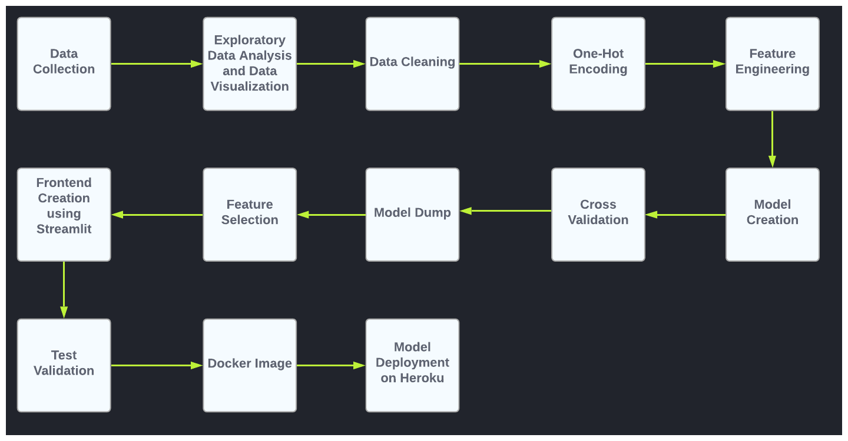
Architecture

Slide 5
Data Validation and Data Transformation
Name Validation - Validation of files name as per the DSA.
Number of Columns - Validation of number of columns present in the files are 15
Name of Columns - The name of the columns in validation and training are changed according to preference.
Data types of columns - The data types of columns is given in the schema file. It is validated when we insert the files into Database.
Null values in columns - If any of the columns in a file have the values as NULL or missing.

Slide 6
Data Insertion in Database:
Table Creation :- Table name “data” is created in the database for inserting the files. If the table is already present then new files are inserted in the same table.
Insertion of files in the table :- All the files are inserted in the above-created table. If any file has invalid data type in any of the columns, the file is not loaded in the table.

Slide 7
Data Preprocessing and Model Training
First, we cleaned our dataset properly by removing all null value and duplicate value in the dataset.
Then we performed data preprocessing steps like cleaning the data, handling the categorical values and other etc.
We have created a new feature column based on the columns present in the dataset before using Feature Engineering. The new feature column”Employment Type” is converted from the “Workclass” column. The new column contains values of ‘private’,’government’,’self-employed’ or ‘without-pay’

Slide 8
Using Scipy, we performed correlation with the ‘salary’ column with the ‘point biserial’ method.That given the result that ‘fnlwgt’ and ‘marital-status’ column are negatively correlated with the ‘salary’. So, we dropped those two columns.
Then splitted the whole dataset into a train-test split. As our dataset is Imbalanced, this is handled using SMOTE technique by oversampling the dataset.
After performing the above step the dataset is ready for training. In this step, Logistic Regression, Random Forest, Gradient Boosting, Decision Tree, SVM, XGBoost, Catboost, KNN are used
After training all above models Catboost performed the best, and cross-validation is also done using the ‘RepeatedStratifiedKFold’ method. Which got the accuracy over 80%.
Then the model is saved using pickle file format for model deployment
After the model was ready to deploy. For deployment Heroku platform is used.

Slide 9
Prediction
The testing files are shared in the batches and we perform the same validation operations, data transformation and data insertion on them.
The accumulated data from db is exported in csv format for prediction.
We perform data pre-processing techniques on it.
After pre-processing, model training is done and “Catboost” model performed the best when compared with other models.
Then, the catboost model is used for prediction.

Slide 10
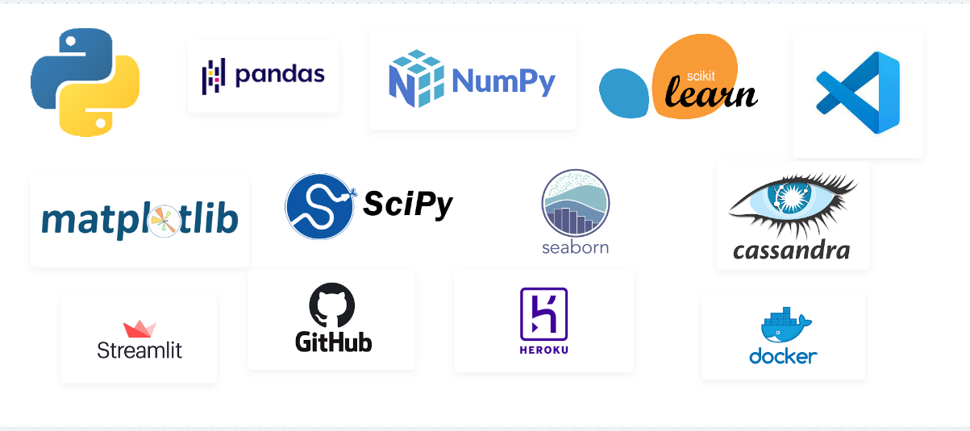
Tools Used

Slide 11
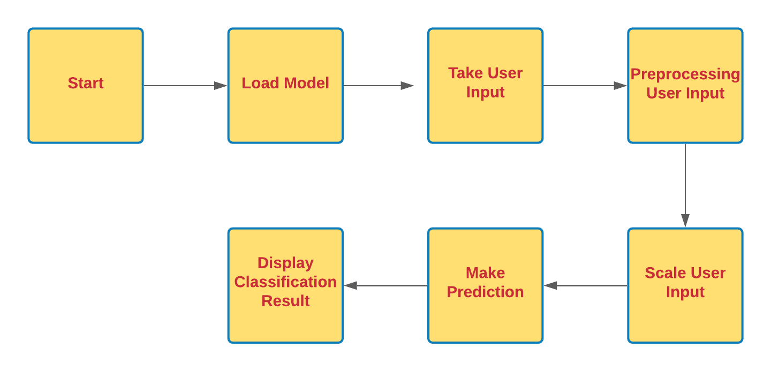
Deployment Process

Slide 12
Q&A
What’s the source of data?
The data for training is provided by the client.
What was the type of data?
The data was the combination of numerical and Categorical values.
What’s the complete flow you followed in this Project?
Refer slide 4th for better Understanding
After the File validation what you do with incompatible file or files which don’t pass the validation?
Files like these are moved to the Achieve Folder and a list of these files has been shared with the client and we removed the bad data folder.

Slide 13
5) How logs are managed?
We are using different logs as per the steps that we follow in
Validation and modelling like File Validation log, Data Insertion,
Model Training log, Prediction log etc.
6) What techniques were using for data pre-processing?
Removing unwanted attributes
Visualizing relation of independent variables with each other and output variables
Checking and changing Distribution of continuous values
Cleaning data and imputing if null values are present.
Converting Categorical data into numeric values.
Creating a new features according to preferences.

Slide 14
7) How training was done or what models were used?
After data preprocessing and feature engineering, the data is divided into training and validation.
Different algorithms are been used and in only Catboost is performed the best and it is been used as final model.
8) How prediction was done?
The testing files are shared by the client. Then on the basis of model is loaded and perform prediction. In the end we get the accumulated data of predictions.
9) What are the different stages of deployment?
When the model is ready we build the app using Strealit.
After, the app is build then for the the deployment Heroku environment is used.

Slide 15
END

